Slide 1
ARTIFICIAL NEURAL NETWORK
DEPARTMENT OF SOFTWARE ENGINEERING
PROJECT Title: Fashion Item Classification System Using CNN
INSTRUCTOR: Sir Hassan Dawood
STUDENTS: Ghufran Ullah (20-SE-34)
Muhammad Noman Shafique (20-SE-38)

Slide 2
INTRODUCTION
In this project, we're creating an end-to-end image classification system using CNNs for the Fashion MNIST dataset, which includes grayscale images of fashion items such as t-shirts, tops, ankle boots, sneakers, etc. Our aim is to process, train, and deploy a neural network model as a Streamlet web app.

Slide 3
AGENDA
Work-flow
Google Collaboratory
Fashion MNIST dataset present in tenser flow library
Streamlet web app

Slide 4
Workflow
Load and prepare Dataset From Tensor flow
Dataset Preprocessing
Building CNN
Training Model
Model Evaluation
Plotting Accuracy values
Streamlet web App demo

Slide 5
IMPORTING DEPENDENCIES
# Set seeds for reproducibility
import random
random.seed(0) #to remove randomness
import numpy as np
np.random.seed(0) import tensorflow as tf
tf.random.set_seed(0)
from tensorflow.keras import datasets, layers, models import matplotlib.pyplot as plt # to plot images and anlyze it
fashion_mnist = datasets.fashion_mnist
(train_images, train_labels), (test_images, test_labels) = fashion_mnist.load_data()

Slide 6
DATA PRE-PROCESSING
type(train_images)
type(train_labels)
print(len(train_images))
print(len(train_labels))
print(len(test_images))
print(train_images[0].shape)
print(type(train_images[0]))
print(train_images[0])
# Display an image from the dataset
plt.imshow(train_images[60], cmap='gray')
plt.show()
print(train_labels[0])

Slide 7
DATA PRE-PROCESSING
# Normalize pixel values to be between 0 and 1
train_images, test_images = train_images / 255.0, test_images / 255.0
# Reshape images to specify that it's a single channel (grayscale)
train_images = train_images.reshape((train_images.shape[0], 28, 28, 1))
test_images = test_images.reshape((test_images.shape[0], 28, 28, 1))
train_images.shape
test_images.shape

Slide 8
BUILDING CONVOLUTION NEURAL NETWORK
# Build the convolutional base
model = models.Sequential()
model.add(layers.Conv2D(32, (3, 3), activation='relu', input_shape=(28, 28, 1)))#32 filters/kernals
model.add(layers.MaxPooling2D((2, 2))) #used to decrease the spatial
model.add(layers.Conv2D(64, (3, 3), activation='relu')) #64 filters/kernals,
model.add(layers.MaxPooling2D((2, 2)))
model.add(layers.Conv2D(64, (3, 3), activation='relu'))
# Add Dense layers on top
model.add(layers.Flatten())
model.add(layers.Dense(64, activation='relu'))
model.add(layers.Dense(10)) #output layer with default linearr activation func.
Notes:
this architecture is common for image classification tasks with CNNs: a stack of convolutional layers followed by max-pooling layers to extract features, and then fully connected layers for classification.

Slide 9
COMPILE & TRAIN MODEL
# Compile and train the model
model.compile(optimizer='adam’,loss=tf.keras.losses.SparseCategoricalCrossentropy(from_logits=True),metrics=['accuracy’])
history = model.fit(train_images, train_labels, epochs=5,
validation_data=(test_images, test_labels))

Slide 10
MODEL EVALUATION & PLOTTING
# Evaluate the model
test_loss, test_acc = model.evaluate(test_images, test_labels, verbose=2)
print('\nTest accuracy:', test_acc)
# Plot training & validation accuracy values
plt.plot(history.history['accuracy'])
plt.plot(history.history['val_accuracy'])
plt.show()
# Plot training & validation loss values
plt.plot(history.history['loss'])
plt.plot(history.history['val_loss'])
plt.show()
model.save('trained_fashion_mnist_model.h5')

Slide 11
THE END

Slide 12
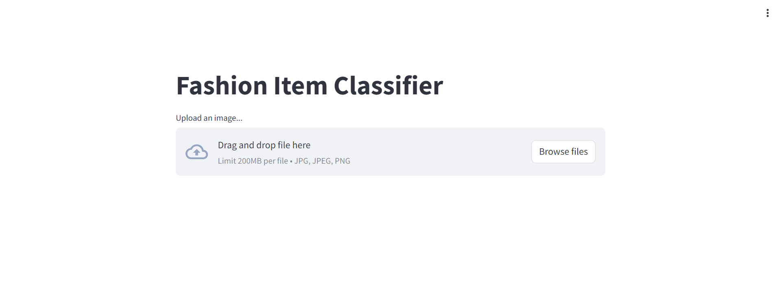

Slide 13
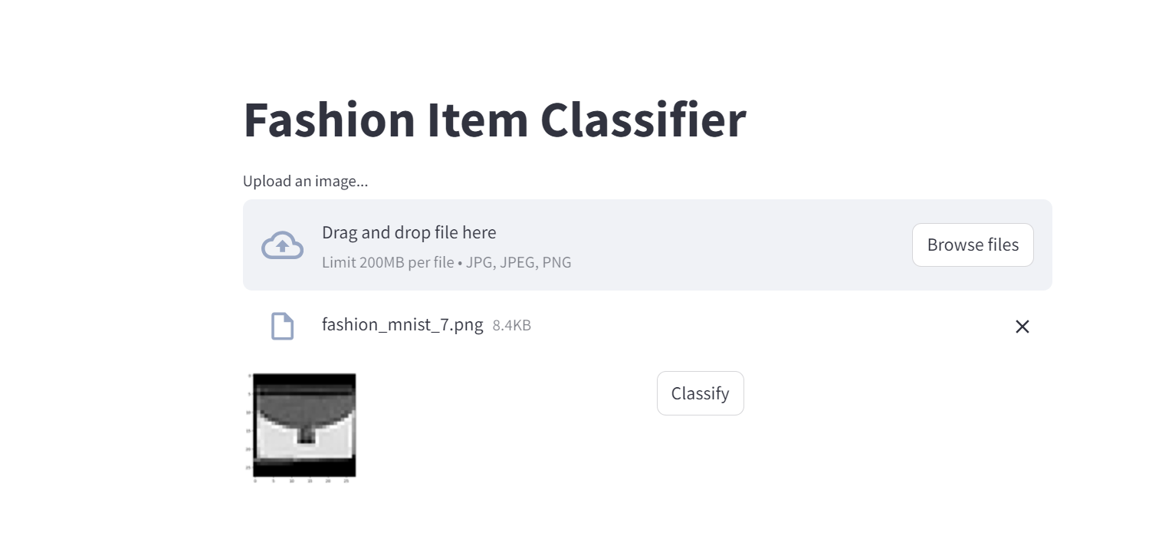

Slide 14
